Slide 1
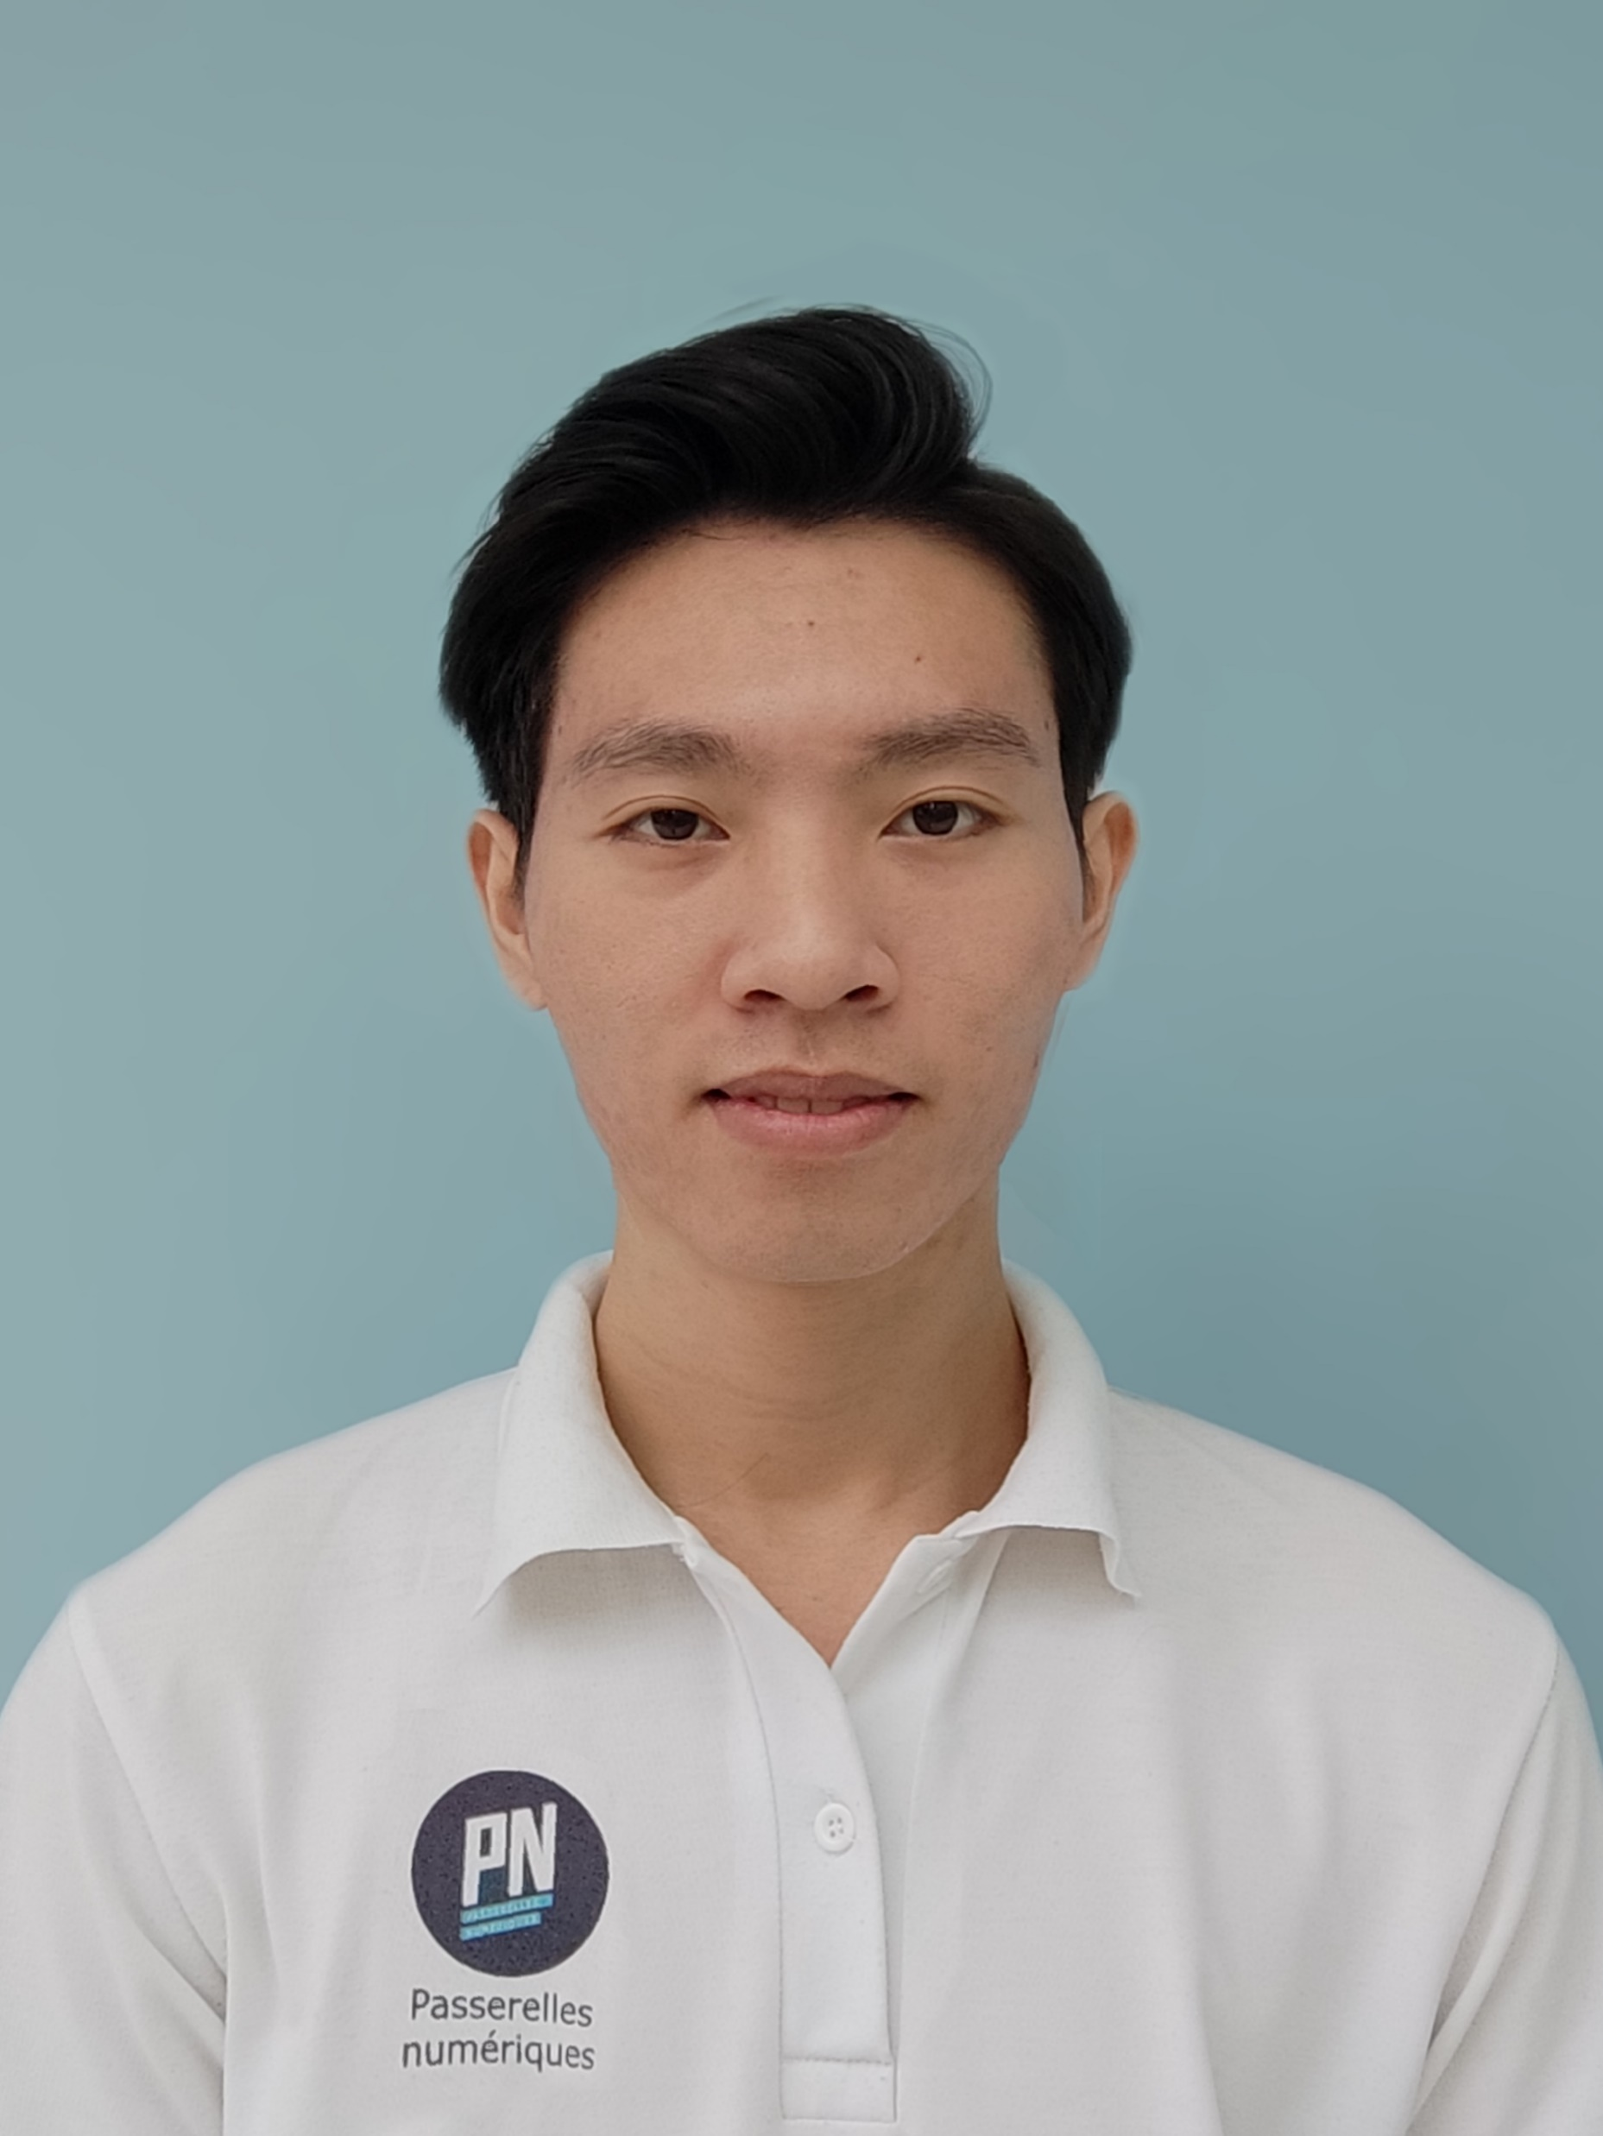
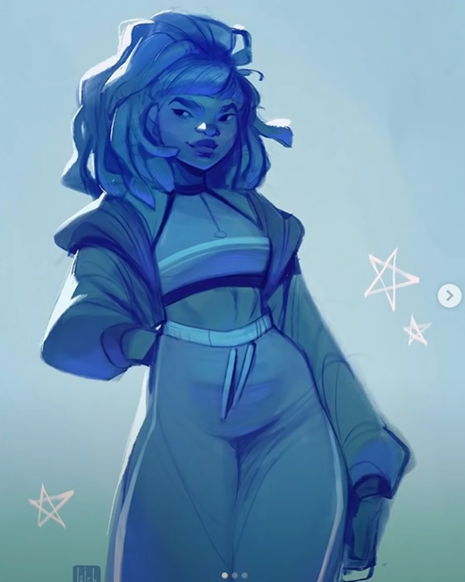
NGUYEN BUI TAI LINH
linh.nguyenbuitai23@student.
passerellesnumeriques.org
0839266965
<Education> <!-2020-2023->
Passerelles Numériques Vietnam
Bachelor of Information Technology
Second-year student
Education program:
Information Technology
Professional life training
English
Front-End
Developer Intern
<Programming languages>
JavaScript <!-main>
Java
Python
Mysq
<Project experience>
Blue Sky - Web project <!-Oct 2021->
Team leader
<Web skills>
HTML
CSS
JavaScript
Figma
UI/UX
Bootstrap
Adobe photoshop
A product to introduce a gym center and sell food supplements.
https://tailinhpn.github.io/Bluesky
The Band - Web project <!-Aug 2021->
Individual
A product to introduce a band and sells music tickets.
<Working languages>
English
Vietnamese
https://tailinhpn.github.io/The-Band
Isolation area management
- Java OOP project <!-Jan 2021->
Team leader
<Reference>
Mr. Vo Cong Dinh
IT teacher
(+84) 905 729 707
A product about personnel management in the centralized isolation area.
https://tailinhpn.github.io/JavaOPP
dinh.cong@
passerellesnumeriques.org
<Portfolio>
About me and my projects
https://tailinhpn.github.io/Portfolio

Slide 2
NGUYEN BUI TAI LINH
linh.nguyenbuitai23@student.passerellesnumeriques.org
0839266965
Dear Mr. and Mrs.
Through the job advertisement "Recruiting Front-End Intern in Ho Chi Minh - DXC Technology" I found at 123job.vn, I learned that your company is looking for a Front-End Intern. I look forward to trying my best in the dynamic working environment of your company. With the current qualifications and experience and the requirements set forth by your company, I am confident that I can take on this role well at DXC Technology.
As mentioned in the attached profile, I am just a student in school and have not much practical experience at the Company. However, with a sense of responsibility, an attitude of always learning along with management experience time, critical thinking, presentation skills, and teamwork skills, and with the knowledge that I have learned at an International organization teaching information technology, I believe I have enough knowledge about Soft skills as well as specialized skills, I am completely confident with the position of an intern at your company.
Thank you for taking your valuable time to review this cover letter. I hope you can arrange a recent face-to-face interview so that I can better present myself and learn more detailed requirements for your Front-End Intern position DXC Technology.
Best regards. Thank you!
Ho Chi Minh - DXC
Technology
Signature
.
Nguyen Bui Tai Linh

